Slide 1
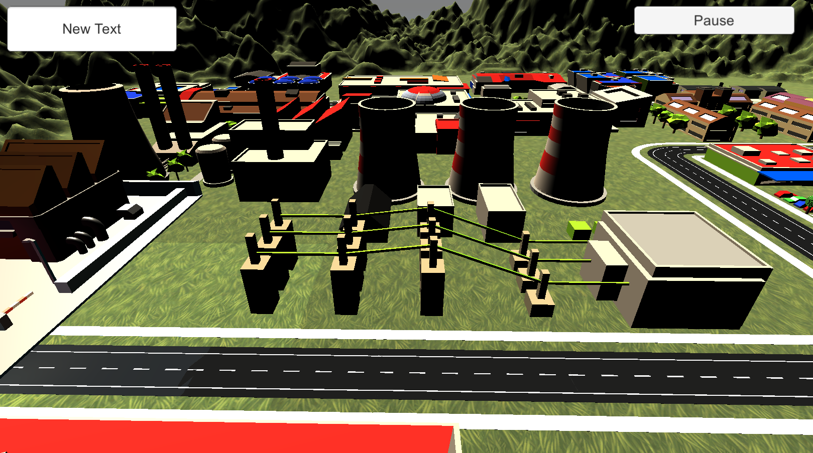
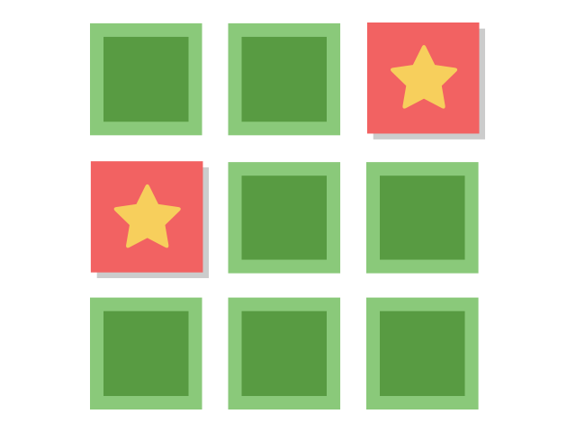
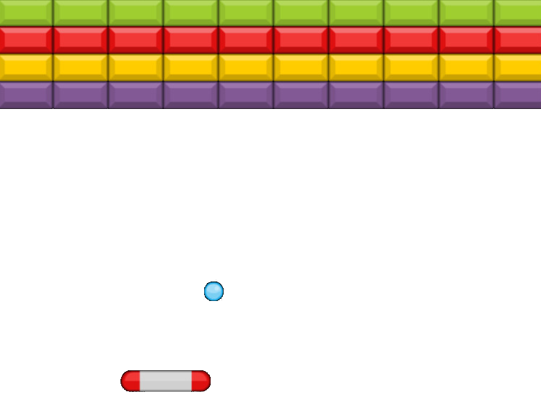
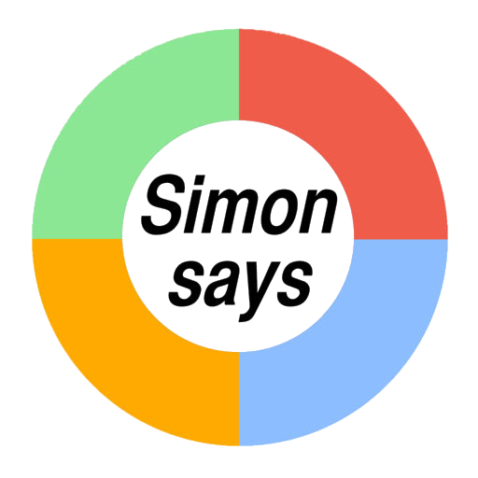

Player: Sam Score: 500
Minigames
Memory
Breakout
Simon Says
Mastermind

Slide 2

Player: Sam Score: 500
Minigames

Slide 3
Player: Sam Score: 500
Minigames

Slide 4
Player: Sam Score: 500
Minigames

Slide 5
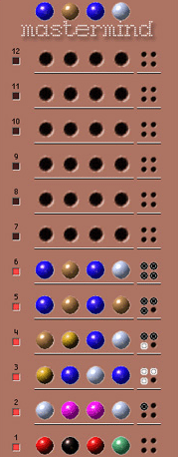
Player: Sam Score: 500
Minigames

